Slide 1


What we learn:
Why we need to learn coding?
How we learn?
C# Programming language
Object Oriented Programming
Files and Databases.
Introduction to web development.

Slide 2
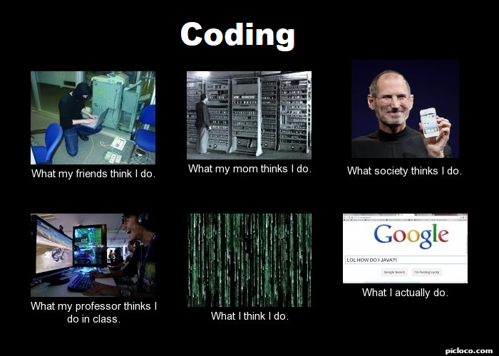
Coding? Programming?
Do you need to be smarter than others to learn coding?
Why learn to code?
I need you to answer these questions.
What is this course about?
How I will assist you in this journey?
What do you need to do to learn coding?
Questions:
List computers I used every day. Directly or indirect:
As I am using computers everyday, do I need to know how they work?
Coding could help me in this ways:
Why do we enjoy solving problems?
I can work on coding everyday for about …?
How will I keep motivated and focus on coding?

Slide 3
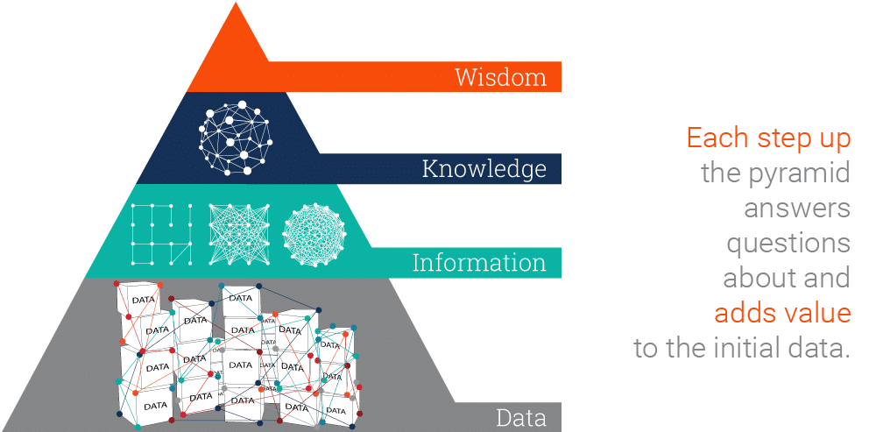
How Computer works?
What Computers are good at?
Basic Knowledge:
Hardware
Software
Operating Systems
Memory
Data > Wisdome

Slide 4
Programming Language
How it works?
C# language

Slide 5
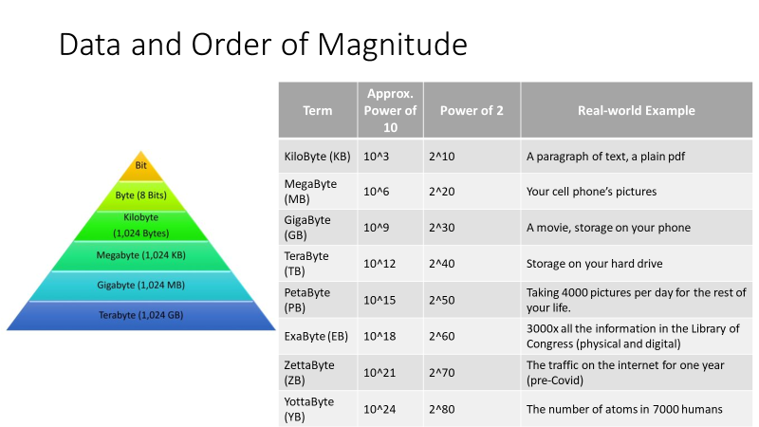
Programming Language
How it works?
C# language

